Slide 1
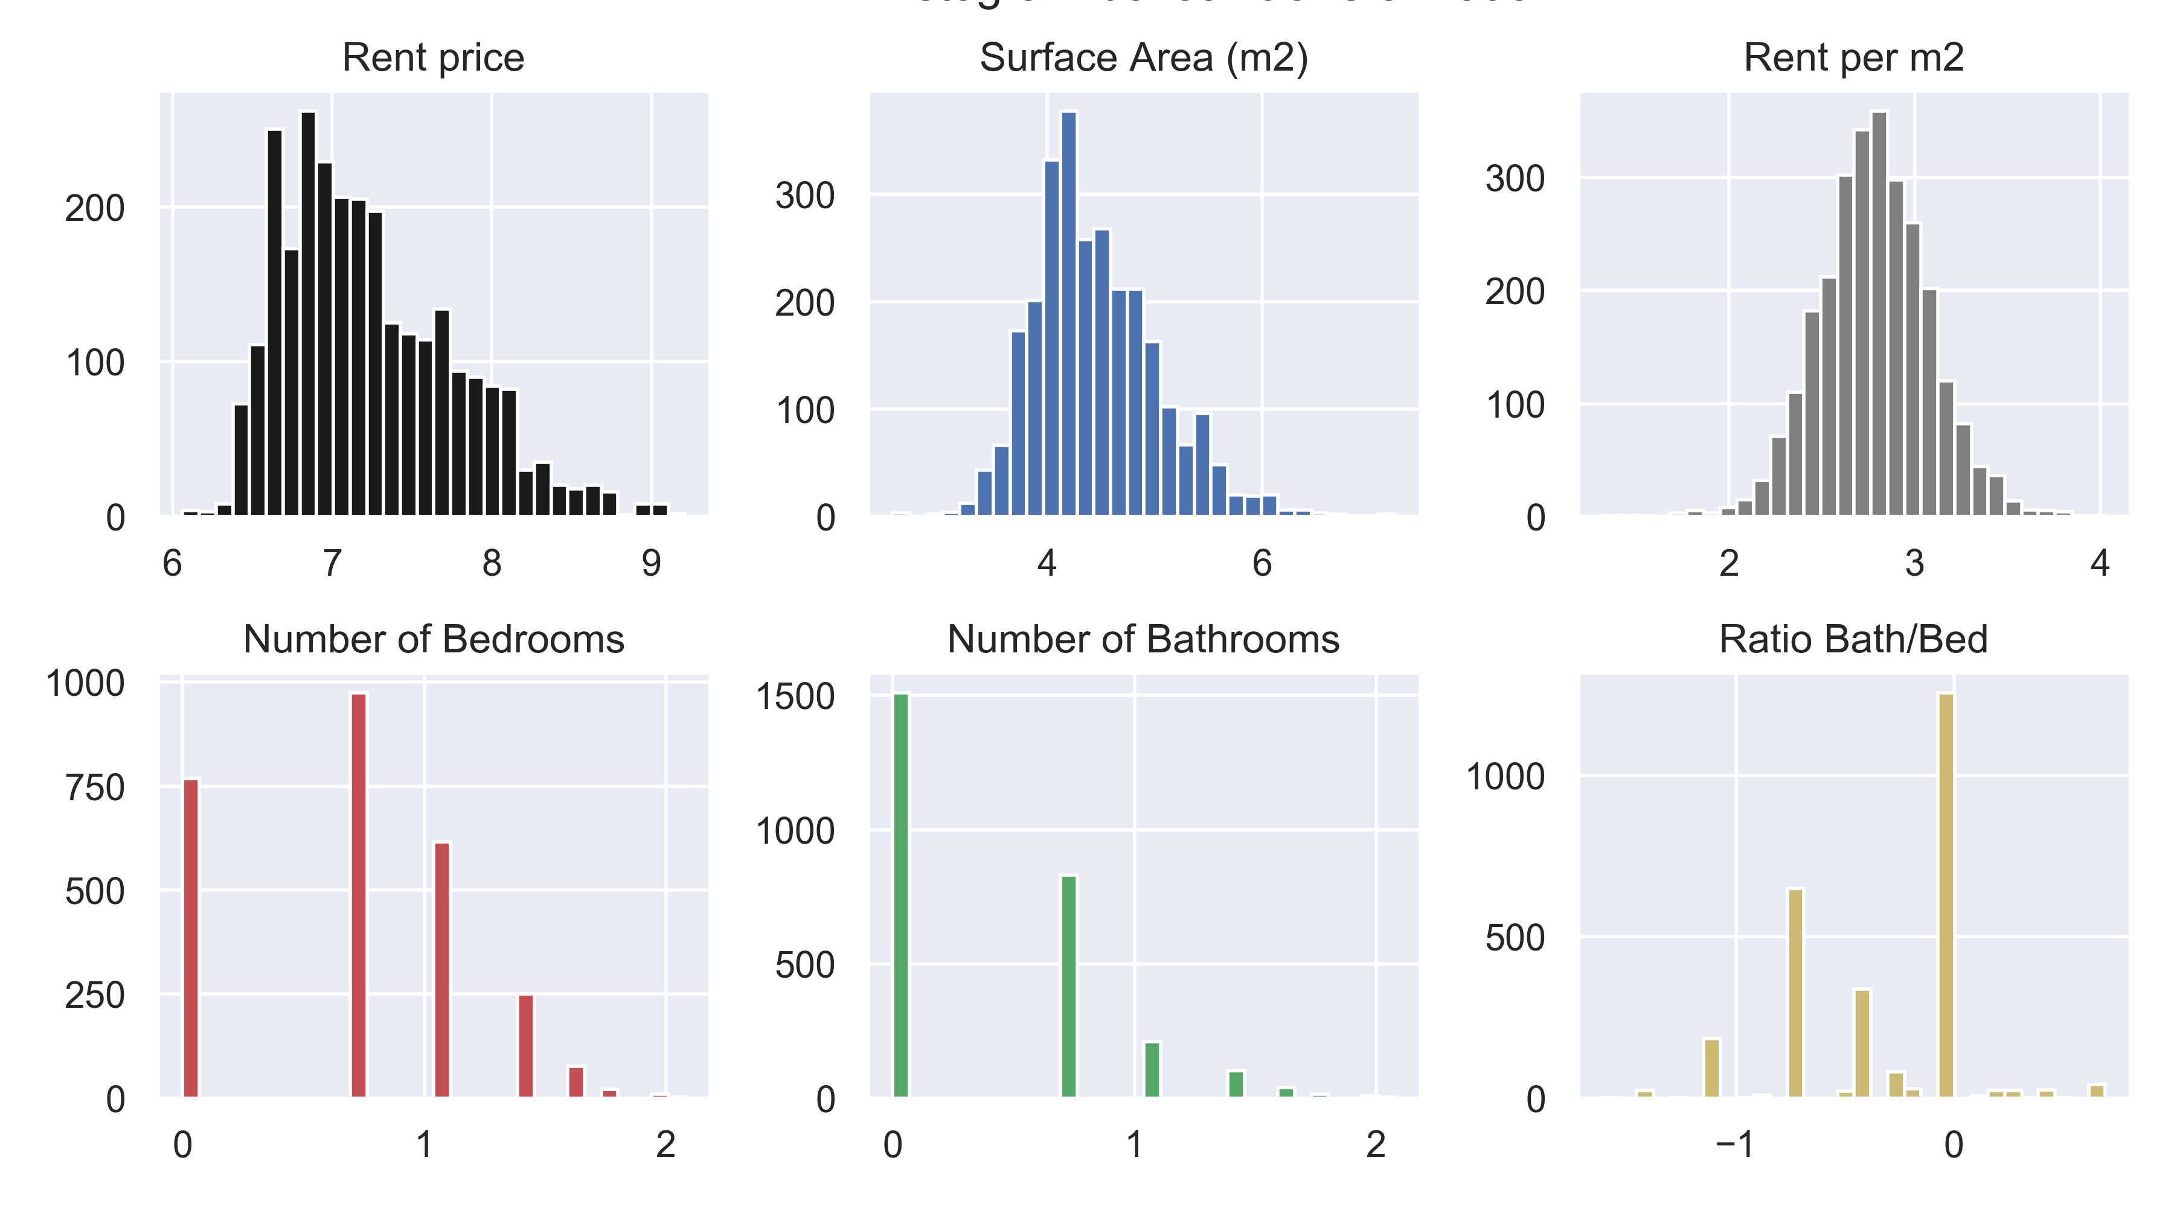
Histograms (after Boxcox transformation)

Slide 2
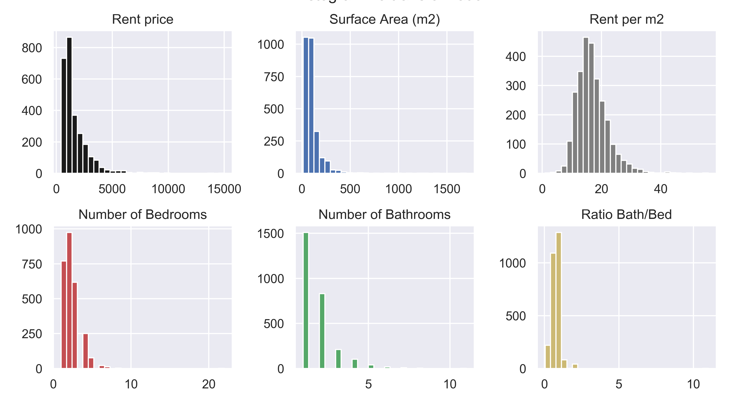
Histograms (before transformation)

